Slide 1
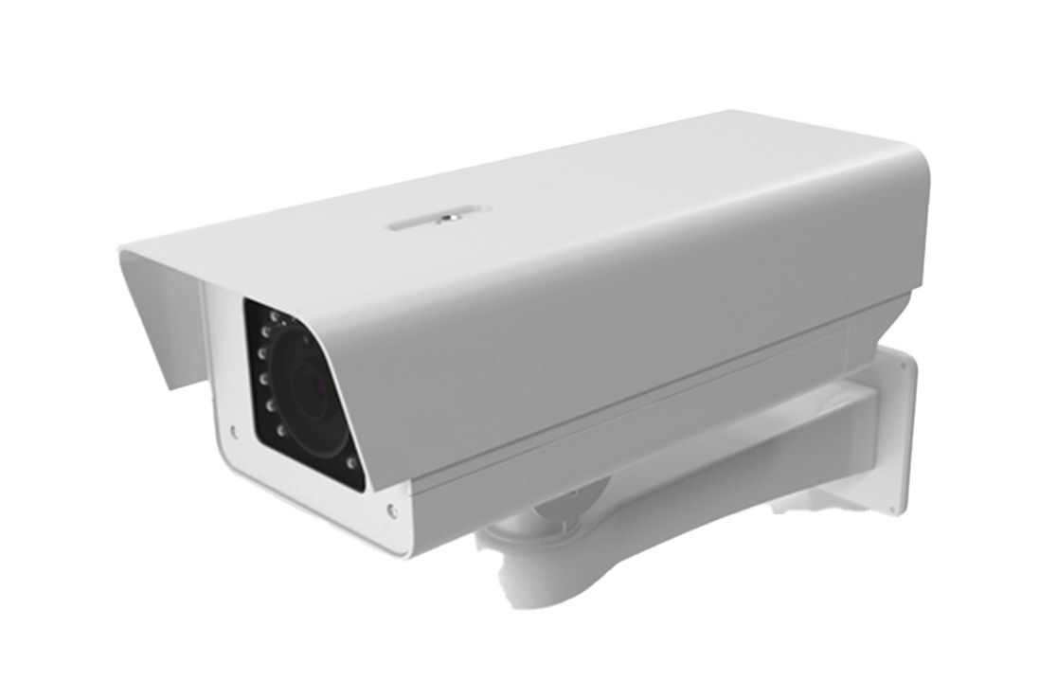
TRAFFIC ANALYZER
TO - MR.AKHILESH SHRIVAS
Assistant Professor of CSIT , GGU
MCA 4th Semester
BY- novel kathor
Roll No - 22072136

Slide 2


Slide 3
introduction
Traffic Analyzer is an advanced computer vision-based application designed for traffic monitoring and analysis. Utilizing YOLO (You Only Look Once) object detection technology, the application processes video feeds to identify and track vehicles, detect lane violations, and analyze traffic patterns. The system integrates both frontend and backend components to deliver real-time insights and visualizations. The frontend, built using React, provides an interactive user interface for video uploads, drawing on snapshots, and viewing real-time data. The backend, developed with FastAPI, handles video processing, object detection, and data communication via WebSocket. This tool aims to enhance traffic management and safety by providing accurate and timely traffic data.

Slide 4
Initial Description of Problem
In the context of modern transportation systems, monitoring and analyzing vehicular movement is crucial for traffic management and safety. However, traditional methods of traffic analysis and lane violation detection are often labor-intensive, time-consuming, and prone to human error. As traffic density increases in urban areas, there is a growing need for automated systems that can efficiently track vehicles, detect lane violations, and provide real-time insights to authorities.

Slide 5
Key challenges include:
Real-Time Processing: Ensuring that the system can process and analyze video streams in real-time to detect lane violations as they happen.
Accurate Detection: Implementing a robust object detection algorithm that can accurately identify vehicles, even in challenging conditions such as poor lighting, occlusion, or high-speed movement.
Scalability: Developing a system that can handle multiple video streams from various locations simultaneously.
User-Friendly Interface: Creating an intuitive interface that allows users to easily set up and monitor the system, including drawing lanes for violation detection.
Wireless Connectivity: Using IP and port to make the system wireless, allowing for greater flexibility and ease of deployment without the need for extensive cabling.

Slide 6
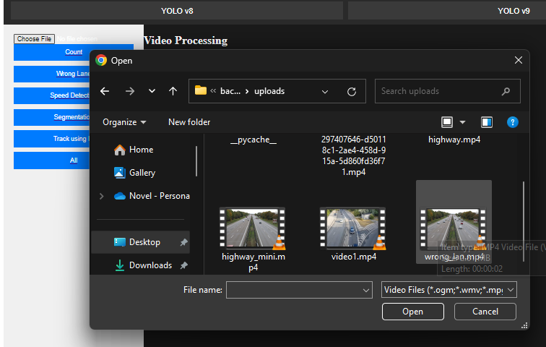
Traffic analyzer at action
PROCESSING UP LOADED VIDEO:
User can uploads a offline video file from the local device

Slide 7
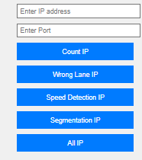
Or user can provide the IP and Port number

Slide 8
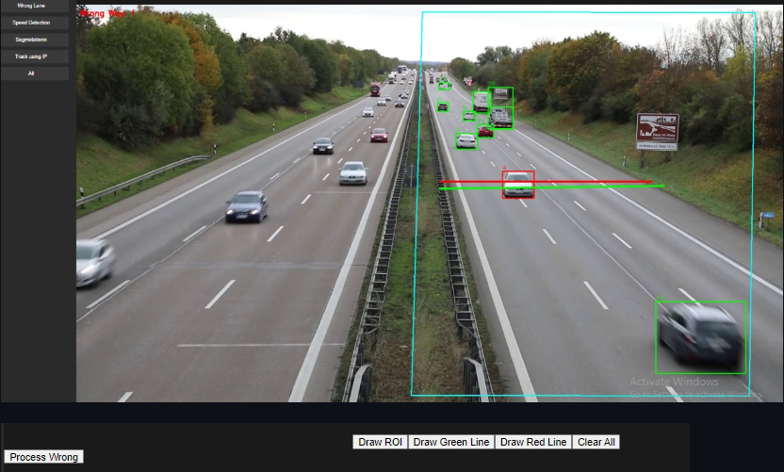
Draw ROI and Lines:
User draws regions of interest and lines on the video.

Slide 9
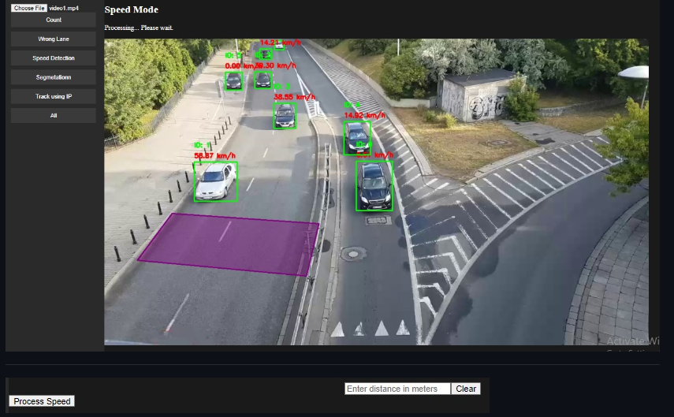
Process Video:
The VideoFeed class processes each frame.
The Vehicle class detects and tracks vehicles.
The Alert class generates alerts for wrong lane usage and speed violations

Slide 10
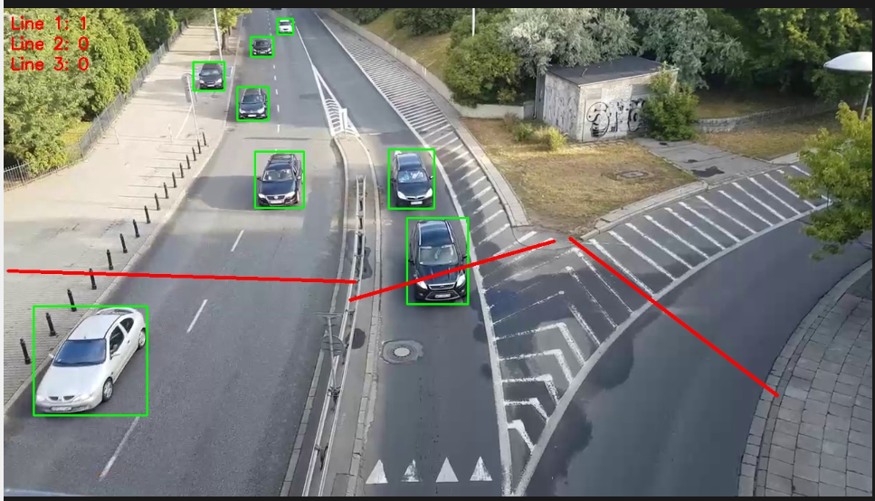
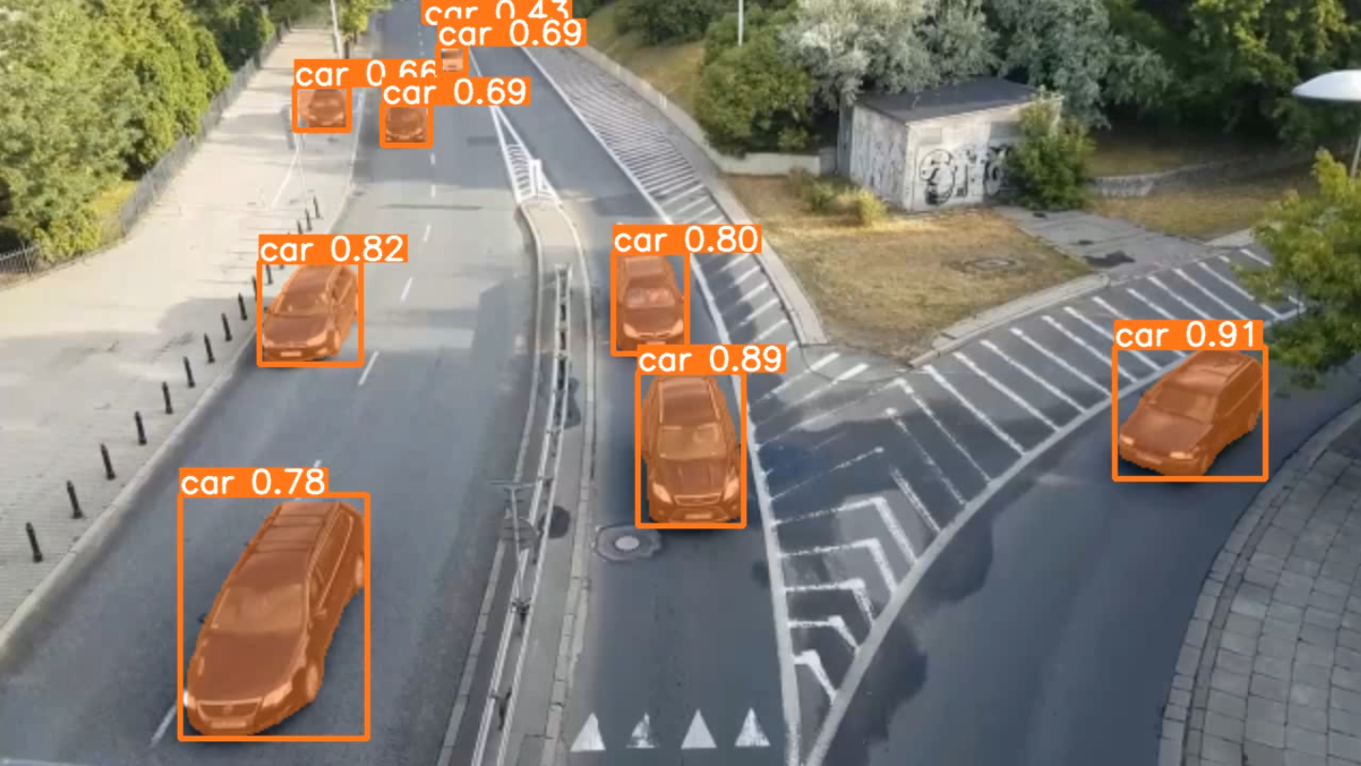
Wrong Lane detection
Counting vehicles
Segmentation
Speed Detection

Slide 11
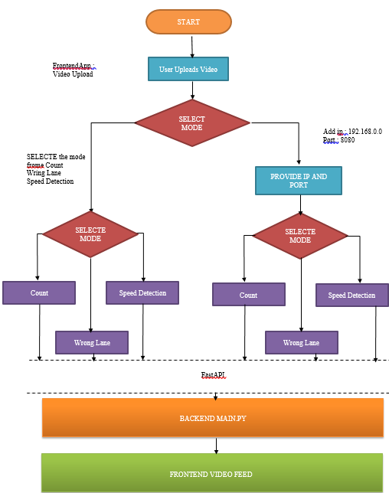
Event flow diagram

Slide 12
Future enhancements
Enhanced Real-time Processing:
Improving the efficiency of real-time processing capabilities, especially for users with low-end hardware, will be a priority. This can be achieved by optimizing algorithms and exploring the use of more efficient data structures and processing techniques.
Advanced Detection Features:
Integration of advanced detection features such as accident detection and fire detection will greatly enhance the functionality of the Traffic Analyzer. These features can provide critical real-time alerts to traffic management authorities.
Scalability Improvements:
Enhancing the scalability of the application to handle multiple video feeds simultaneously will be crucial for its adoption in larger traffic management systems. Implementing distributed processing and leveraging cloud-based solutions could address these scalability concerns.
User Interface Enhancements:
Simplifying the user interface to make it more intuitive and user-friendly will be beneficial. Providing comprehensive user guides, tooltips, and onboarding tutorials can help users better understand and utilize the application's features.

Slide 13
Integration with Existing Traffic Management Systems:
Developing APIs and plugins that allow seamless integration with existing traffic management systems will expand the application’s usability. This can facilitate data sharing and real-time collaboration between different systems.
Machine Learning and AI Improvements:
Continuous improvement of the underlying machine learning and AI models to enhance detection accuracy and reduce false positives/negatives. This can be achieved by training the models on diverse datasets and incorporating the latest advancements in computer vision and deep learning.
Expanded Support for Various Camera Types:
Extending support to various types of cameras, including drones and stationary traffic cameras, will enhance the versatility of the application. This will allow for more comprehensive monitoring of traffic from different perspectives.
Mobile Application Development:
Developing a mobile version of the Traffic Analyzer to provide on-the-go access to traffic analysis features. This can be particularly useful for traffic management authorities who need to monitor traffic conditions remotely.
Enhanced Security and Privacy Measures:
Implementing stronger security and privacy measures to protect the data processed by the application. Ensuring compliance with relevant data protection regulations and standards will be essential.

Slide 14
CONCLUSIONS
Traffic Analyzer represents a significant advancement in the field of traffic management, leveraging cutting-edge computer vision technologies to provide comprehensive monitoring and analysis tools. The development and deployment of this web application have showcased the potential for technology to enhance road safety and efficiency. This conclusion highlights the key outcomes, impacts, and future prospects of Traffic Analyzer.
Improved Traffic Management:
Traffic Analyzer equips traffic management authorities with vital tools to monitor and manage traffic flow more effectively, leading to better decision-making and resource allocation.
Enhanced Road Safety:
By detecting wrong lane usage and monitoring vehicle speeds, the application contributes to increased road safety, potentially reducing accidents and violations.
Data-Driven Insights:
The application provides actionable data and real-time statistics, helping authorities understand traffic patterns and identify areas needing intervention.

Slide 15
Thanks!

